Slide 1
Apache Slider
Shivaji Dutta
Sr. Partner Solutions Engineer

Slide 2
Disclaimer
This document may contain product features and technology directions that are under development or may be under development in the future.
Technical feasibility, market demand, user feedback, and the Apache Software Foundation community development process can all effect timing and final delivery.
This document’s description of these features and technology directions does not represent a contractual commitment from Hortonworks to deliver these features in any generally available product.
Product features and technology directions are subject to change, and must not be included in contracts, purchase orders, or sales agreements of any kind.

Slide 3
Agenda
Apache Slider Overview
Yarn Overview
Why Slider
Slider Internals/Architecture
Slider App Packaging
Ambari and Slider
Q/A

Slide 4
Slider Overview

Slide 5
Apache Slider
Open Source in-incubation Project
http://slider.incubator.apache.org/index.html
Platform for
Deployment, Management & Monitoring
Long Running applications on a Hadoop/YARN Cluster
Built and Runs on Hadoop YARN Framework
It makes it EASY and SIMPLE
Notes:
Apache Slider
It is an open source project.
Deployment, Management and Monitoring
Distributed Application on a Apache YARN Cluster

Slide 6
YARN

Slide 7
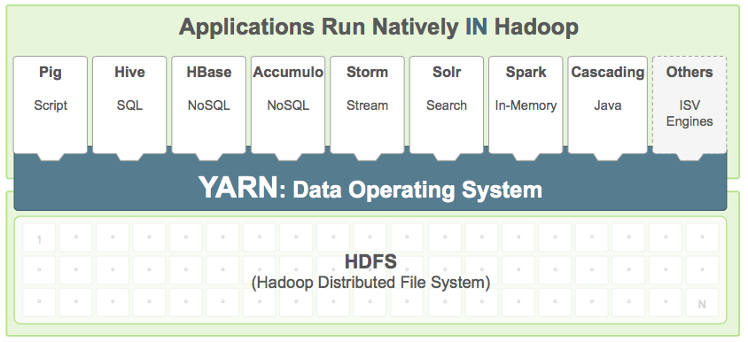
YARN as Cluster Operating System
Hadoop 2.0
Resource Manager for Hadoop Cluster
Notes:
What YARN Does
YARN enhances the power of a Hadoop compute cluster in the following ways:
Scalability
The processing power in data centers continues to grow quickly. Because YARN ResourceManager focuses exclusively on scheduling, it can manage those larger clusters much more easily.
Compatibility with MapReduce
Existing MapReduce applications and users can run on top of YARN without disruption to their existing processes.
Improved cluster utilization.
The ResourceManager is a pure scheduler that optimizes cluster utilization according to criteria such as capacity guarantees, fairness, and SLAs. Also, unlike before, there are no named map and reduce slots, which helps to better utilize cluster resources.
Support for workloads other than MapReduce
Additional programming models such as graph processing and iterative modeling are now possible for data processing. These added models allow enterprises to realize near real-time processing and increased ROI on their Hadoop investments.
Agility
With MapReduce becoming a user-land library, it can evolve independently of the underlying resource manager layer and in a much more agile manner.

Slide 8
YARN
A global ResourceManager
A resource arbitrator for the cluster
A per application ApplicationMaster
A resource negotiator for the Application
Works with the Node Manager to Launch Application Containers
A per-node slave NodeManager
Manages Resources on a Node
a per-application Container running on a NodeManager
Actual application running in the container

Slide 9
YARN Flow
ResourceManager
Client₂
Scheduler
Client₁
NodeManager
NodeManager
NodeManager
NodeManager
Container _{1.1}
Container _{2.2}
Container _{2.4}
NodeManager
NodeManager
NodeManager
NodeManager
AM ₁
Container _{1.2}
AM₂
Container _{2.1}
NodeManager
NodeManager
NodeManager
NodeManager
Container _{1.3}
Container _{2.3}
Notes:
Servers run YARN Node Managers
NM's heartbeat to Resource Manager
RM schedules work over cluster
RM allocates containers to apps
NMs start containers
NMs report container health

Slide 10
YARN - Powerful but Complex
Powerful – Fine grained control through API
Needs Coding and Development work for creating
Yarn Application Master
Yarn Client
Yarn Container
Complex & Time Consuming to write
For Standard Applications
No Easy way of State Management
THAW
FLEX

Slide 11
Long Running Applications - Difference from Map-Red

Slide 12
Long Running Application - Needs
Management
Install
Configure
Start/Stop
Reconfigure
Activate/Reactivate
Upgrade
Rolling Upgrade
Security
Scalability
Monitoring

Slide 13
Slider

Slide 14
Why Slider ?
Full YARN-integration takes effort
Code for every component and action
Powerful and finer control
YARN delivers access to all the data in HDFS –and the Cluster Resources
Maturing Hadoop stack needs an Agile platform to integrate
E.g. HBASE, HIVE, MAP REDUCE, APP Servers
Integrate to Management tools like - Ambari– to monitor applications in-a cluster

Slide 15
Slider’s view of an Application
An application is a set of components
A component is a daemon/launched exe
configuration
scripts, data files, etc.
Component may have one or more instances
Component instances are managed
Example
HBase Application (3 components)
HBase Master
HBase RegionServer
HBase REST service

Slide 16
Slider – Design (On Yarn)
Slider Client
YARN Resource Manager
HDFS
YARN Node Manager
YARN Node Manager
AppMaster (container)
Component (container)
Slider Agent
Slider AppMaster
Application
HDFS
HDFS

Slide 17
Application by Slider
CLI starts an instance of the AM
AM requests containers
Containers activate with an Agent
Agent gets application definition
Agent registers with AM
AM issues commands
Agent reports back, status, configuration, etc.
AM publishes endpoints, configurations
Slider
App Package
Slider
CLI
YARN Resource Manager “The RM”
1
2
YARN Node Manager
HDFS
7
App Master/Agent Provider
5
7
5
6
Agent
Component
3
HDFS
YARN Node Manager
4
8
Application Registry
6
Agent
Component
3
HDFS
4

Slide 18
Slider AppMaster/Agent/Client
AppMaster
Common YARN interactions
Common *-client interactions
Publishing needs
Agent
Configure and start
Re-configure and restart
Heartbeats & failure detection
Port allocations and publishing
Custom commands if any (e.g. graceful-stop)
Client
App life cycle commands (flex, status, …)

Slide 19
Terminology
Apps on YARN
Application written to run directly on YARN
Packaging, deployment and lifecycle management are custom built for each application
Slider Apps
Applications deployed and managed on YARN using Slider
Use of slider minimizes custom code for deployment + lifecycle management
Requires apps to follow Slider guidelines and packaging ("Sliderize")

Slide 20
Slider – Getting Started

Slide 21
Executing Slider
Install Apache Slider on to a Yarn Cluster
Create a “sliderized” Application Package
Setup the config files
Execute it from Slider client
E.g.
slider <ACTION> [<name>] [<OPTIONS>]
./slider create cl1 --image hdfs://NN:8020/slider/agent/slider-agent.tar.gz --template /work/appConf.json --resources /work/resources.json

Slide 22
Installing Slider
3 easy steps
Download and build apache slider project
Install Slider Client that can access the Hadoop Cluster
Deploy the slider resources
Create the hdfs folders
Done! – Ready to rock!
hdfs dfs -copyFromLocal ${slider-install-dir}/slider-0.40.0/agent/slider-agent.tar.gz /user/yarn/agent

Slide 23
Slider Commands
Sample Slider commands
Build - Build an instance of the given name, with the specific options
Create – Build and run an instance
Destroy - Destroy a (stopped) applicaton instance
Exists - Probe the existence of the named Slider application instance
Flex - Flex the number of workers in an application instance to the new value
Freeze - freeze the application instance. The running application is stopped. Its settings are retained in HDFS.
Complete Man page
http://slider.incubator.apache.org/docs/manpage.html

Slide 24
Slider Application Packaging
The main components
App Configuration
Configurations needed for the Application
appConfig.json
Resources
Resources required to run the application on the cluster
CPU, Memory, Priority
resources.json
Application Definition
MetaInfo.xml
Application jar file
Actual binary file

Slide 25
Memcached on YARN
Sample Slider App

Slide 26
Other Application Packages
Reference doc for Memcached Application
http://slider.incubator.apache.org/docs/slider_specs/hello_world_slider_app.html
Slider github repo has other app
Accumulo
HBase
Storm
Memcached-windows

Slide 27
Next?

Slide 28
Its get Better
Ambari Views for Slider
Ambari View that manages the life cycle of “Slider”ized apps

Slide 29
Thank You

